Slide 1
CCGC 5004 Database Systems
How to code summary queries

Slide 2
Objectives
Code summary queries using aggregate functions, SUM, AVG, MIN, MAX, and COUNT
Include queries that use WITH ROLLUP operator
Use the GROUPING and IF functions
Describe summary queries
Define the difference between HAVING and WHERE

Slide 3
Syntax of Aggregate Functions
AVG([ALL|DISTINCT] expression)
SUM([ALL|DISTINCT] expression)
MIN([ALL|DISTINCT] expression)
MAX([ALL|DISTINCT] expression)
COUNT([ALL|DISTINCT] expression)
COUNT(*)
These are the 5 aggregate functions
Notice COUNT can be used in two different ways

Slide 4
Aggregate Functions
The expression for SUM and AVG functions can result only in a numeric value
MIN, MAX and COUNT functions can result in a numeric, date or a string value
Typically the expression is just a column name, for example you could get the average of all values in the INVOICE_TOTAL column like this:
AVG(invoice_total)
How ever expressions can be more complex
SUM(invoice_total – payment-total – credit_total)
The result would be the single value that represents the total amount of all the selected invoices
The WHERE clause is just selecting invoices that have a balance due

Slide 5
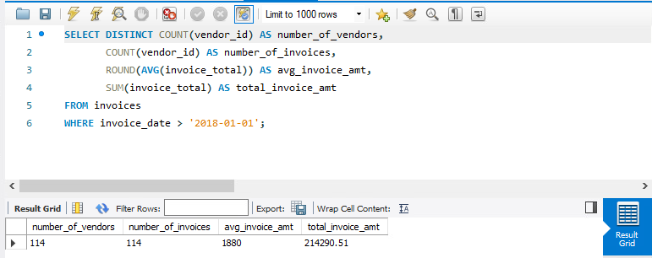
A Summary Query
A summary query is a SELECT statement that includes one or more aggregate function
The expression for SUM and AVG functions can result only in a numeric value
MIN, MAX and COUNT functions can result in a numeric, date or a string value
Typically the expression is just a column name

Slide 6
ALL or DISTINCT Keyword
When you use these functions you can also code the ALL or DISTINCT keyword
The ALL keyword is the default, it does not have to be coded
The example on the previous slide includes ALL which means all values are included in the calculation
The exceptions are NULL values
NULL values are excluded from all functions with the exception of COUNT(*), more on this later
If you do not want duplicate values to be included you can code the DISTINCT keyword
In most cases you will only use the DISTINCT with the COUNT function
DISTINCT has no effect on MIN or MAX functions
Does not usually make sense to use on SUM or AVG

Slide 7
Queries that use Aggregate Functions
We are going to look a few queries that are using aggregate functions
Aggregate functions are also called column functions, they perform a calculation on the values in a set of selected rows
A SUMMARY QUERY is a SELECT statement that includes one or more aggregate functions
Again, the expression for the AVG and SUM functions must result in a numeric value
The expression for the MIN, MAX, or COUNT functions can result in a numeric, date, or string value
All aggregate functions except COUNT(*) ignore NULL values
If you wish to omit duplicate values code the DISTINCT keyword
The DISTINCT keyword is typically used with the COUNT function

Slide 8
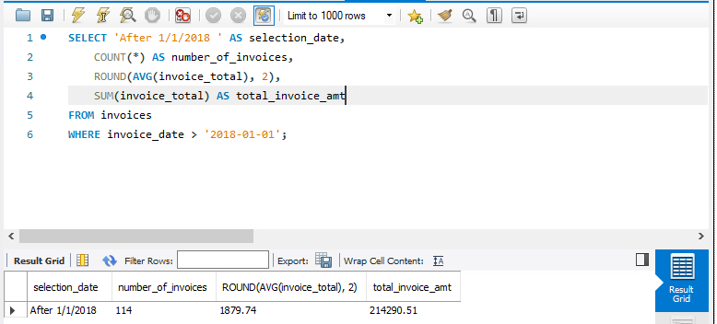
First Sample Query
This query is using the SUM, AVG and COUNT functions
COUNT(*), which uses the * option tells the query to just count the rows, no specific value is to be counted, just count the rows, if there are NULL values it does matter
Notice the ROUND(AVG(invoice_total), 2), shows that the result of the AVG function can be rounded to 2 decimal places

Slide 9
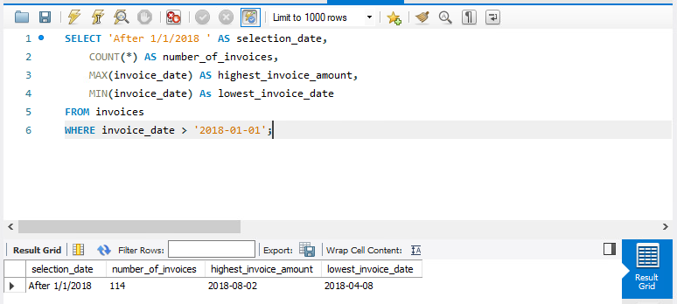
Second Sample Query
In this query the MAX function is being used to find the highest invoice date, while the MIN function is being used to find the lowest invoice date, the MIN and MAX functions can be used to find the maximum and minimum date values
It is also using the COUNT (*) function to count the number of invoices
In this query the MAX function is being used to find the highest invoice total, while the MIN function is being used to find the lowest invoice total, the MIN and MAX functions can be used to find the maximum and minimum numeric values

Slide 10
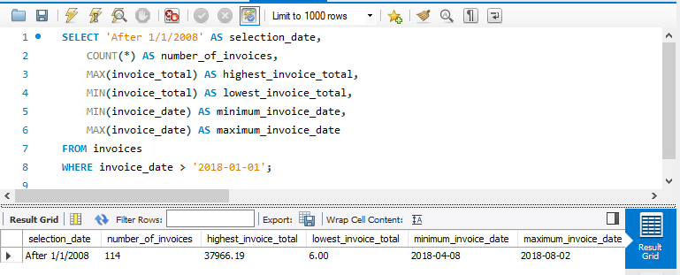
Second Sample Query (Enhanced)
In this query the MAX function is being used to find the highest invoice date, while the MIN function is being used to find the lowest invoice date, the MIN and MAX functions can be used to find the maximum and minimum date values
It is also using the COUNT (*) function to count the number of invoices
In this query the MAX function is being used to find the highest invoice total, while the MIN function is being used to find the lowest invoice total, the MIN and MAX functions can be used to find the maximum and minimum date values

Slide 11
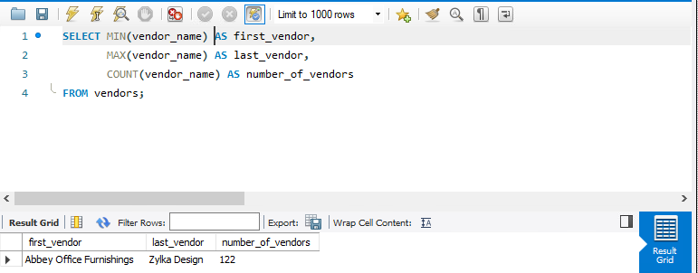
Third Sample Query
The MIN function returns the vendor name that is lowest in the sort sequence
The MAX function returns the vendor name that is highest in the sort sequence
The COUNT(vendor_name) function returns the number of vendor names, the values returned are not null values
Note since VENDOR_NAME cannot contain NULL values the COUNT(*) would return the same value

Slide 12
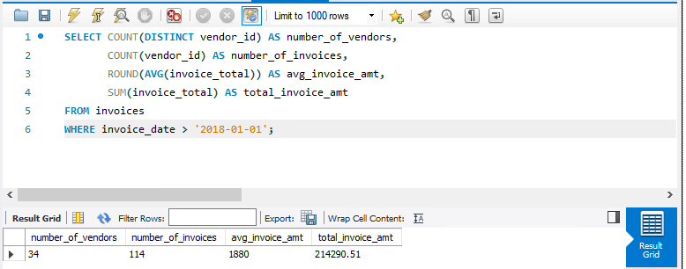
Fourth Sample Query
COUNT(DISTINCT vendor_id)
First of all returns the DISTINCT number of vendor ids
It then COUNT the number of those distinct values
In this query the output shows how the DISTINCT keyword can affect the result of the function
The COUNT function uses the DISTINCT keyword to count the number of vendors that have invoices dated after 1/1/2018
The COUNT(vendor_id) used after is counting the number of distinct vendor ids
The ROUND function did not specify a number of decimal places so by default it is rounded to 0

Slide 13
Beware
A word of caution, do not place the DISTINCT before the COUNT, I have seen this done may times
The COUNT(vendor_id) counts the number of vendor ids, there are 114 of them
The DISTINCT now says give me the distinct number of vendors, well there is only a single value of 114 returned

Slide 14
SELECT with GROUP BY and HAVING - Syntax
SELECT select_list
FROM table_source
[WHERE search_condition]
[GROUP BY group_by_list]
[HAVING search_condition]
[ORDER BY order_by_list]
Now that we have seen how aggregate function work, we are ready to learn how to group data and use aggregate functions to summarize the data in each group
To do this we are introducing to new clauses to the SELECT statement GROUP BY and HAVING

Slide 15
GROUP BY and HAVING Clauses
The GROUP BY clause determines how the selected rows are grouped
The HAVING clause determines which groups appear in the final result
These two clauses are coded after the WHERE clause and before the ORDER BY clause
The WHERE clause is applied before the GROUP BY, the WHERE determines which rows are to be grouped
The rows that meet the WHERE clause condition are grouped
The HAVING clause then determines which groups are to be displayed
The ORDER BY is applied after the rows are grouped

Slide 16
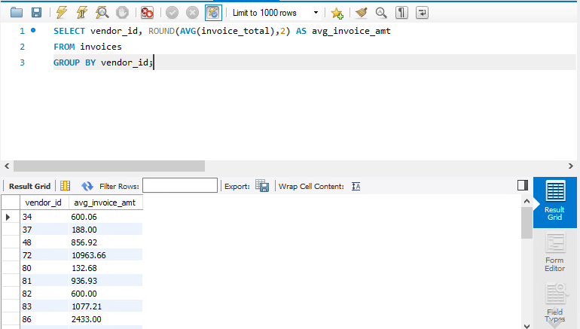
GROUP BY Clause
This statement groups the VENDOR_ID values with the average invoice_total for each VENDOR_ID
The GROUP BY is required since the vendor_id is an individual value and the AVG group function is a group value
The output displays the average invoice amount for each vendor

Slide 17
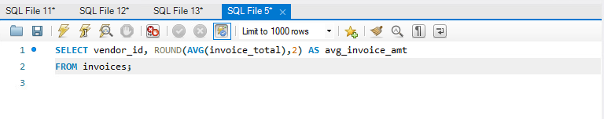
GROUP BY Clause Common Mistake
Over many years I have witnessed students use a group function with a single column value
The issue is they do not use the GROUP BY statement
The query will produce an error and will not display any result set
If you use a group function and a single column value in the SELECT clause together, you must use a GROUP BY clause
If you choose not too, you will receive a syntax error
For the correct result see slide 16

Slide 18
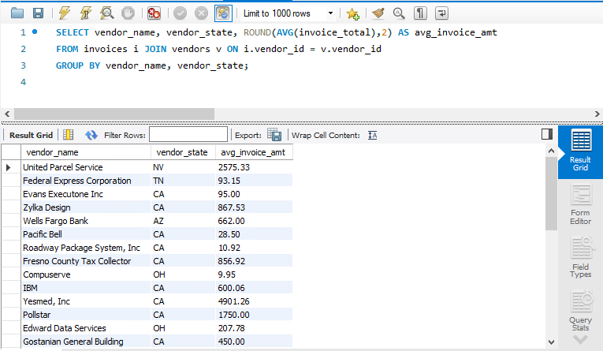
GROUP BY with Multiple Single Column Values
In this example there are two single value columns listed in the SELECT clause
There is VENDOR_NAME and VENDOR_CITY
Both values are then listed in the GROUP BY clause

Slide 19
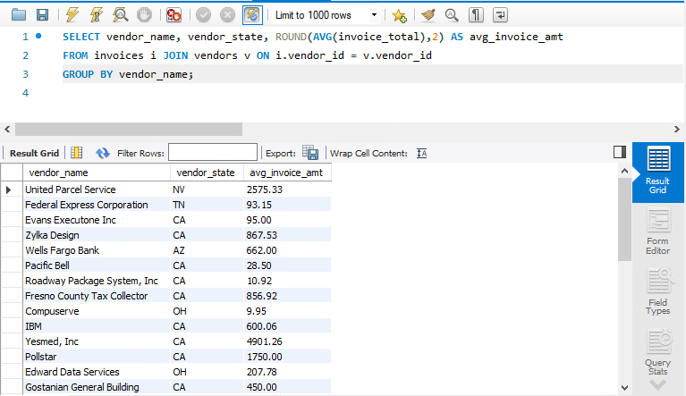
GROUP BY with a Functionally Dependent Column
This concept might confuse some
We just mentioned that you need to list all single value columns in the GROUP BY
Here I did not and there is still a result set displayed
MySQL allows the use of a functionally dependent column to be used and the GROUP BY will still work
In this case this works, VENDOR_NAME is either a PRIMARY KEY or a unique value that is NOT NULL
The value for VENDOR_STATE is functionally dependent on VENDOR_NAME so in this case it works

Slide 20
Safe Method
Even though as we saw on the previous slide that MySQL does permit the omission of the VENDOR_STATE
The safest method is to include it in the GROUP BY then you know you will not have an issue

Slide 21
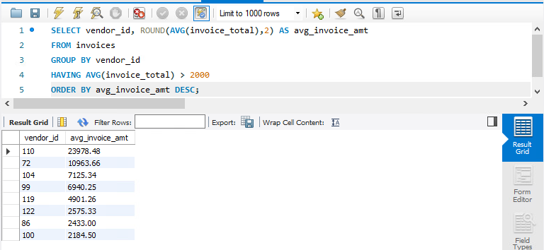
HAVING Clause
Also notice the ORDER BY clause, it is using the alias that was defined in the SELECT clause
The HAVING clause is used to restrict which groups will be displayed
In this case if the AVG(invoice_total) is greater than 2000 it can be displayed in the result set
All of the groups are determined, but if the group is less than 2000 it is not displayed in the result
The final result is sorted on the avg_invoice_amt descending

Slide 22
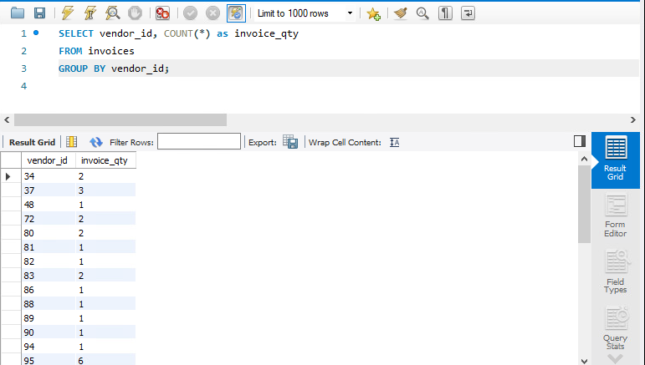
More Examples of GROUP BY with HAVING Clauses
A summary query that counts the number of invoices by vendor
With MySQL 8.0.13 the columns of the GROUP BY clause no longer are sorted by default
The ORDER BY clause is required if you want to be assured the columns are displayed in a particular sequence
Although they may appear in sequence here, it is just the way the data is in the table

Slide 23
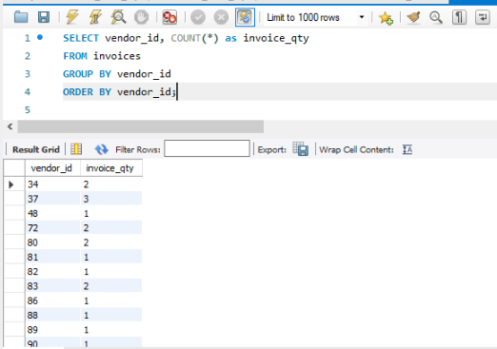
More Examples of GROUP BY with HAVING Clauses
If you wish it to be sequenced on a particular column the proper method is to use the ORDER BY clause
With this method you are assured it is in sequence you have specified

Slide 24
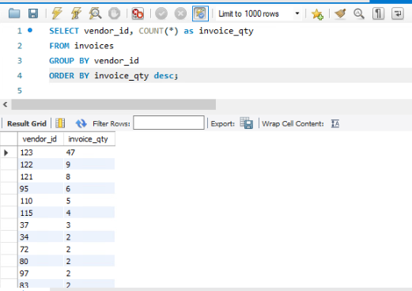
More Examples of GROUP BY with HAVING Clauses
If you wish it to be sequenced on a particular column the proper method is to use the ORDER BY clause
With this method you are assured it is in sequence you have specified
You may also ORDER BY the aggregate column
Notice you are permitted in the ORDER BY to use the alias (invoice_qty) that was applied to the COUNT(*) aggregate function
This will not work with the WHERE clause, in case you have attempted this

Slide 25
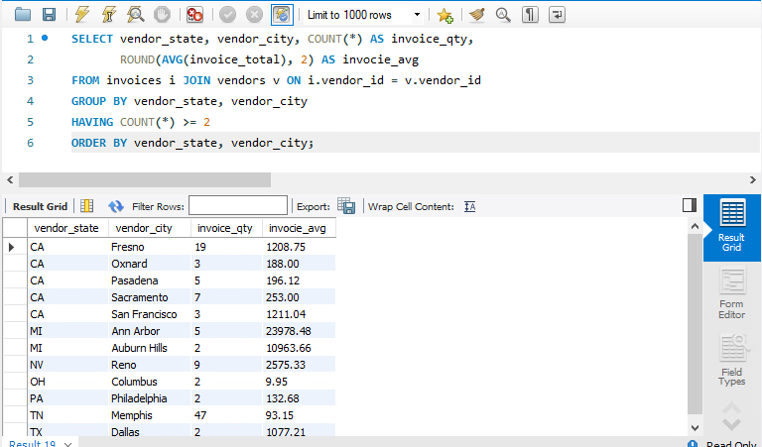
More Examples of GROUP BY with HAVING Clauses
Another example with the HAVING clause to restrict the groups to those with a COUNT of more than 2
You may have noticed that the group function defined in the SELECT clause is the same as the group function in the HAVING clause
May not always be the case but in most cases it is

Slide 26
How the HAVING Clause Compares to the WHERE Clause
As you have seen you can limit the groups included in a result set by including a search condition in the HAVING clause
In addition you can apply a condition to each row before it is included in a group
This is done by coding a condition in the WHERE clause
This is done as it is done for any SELECT statement
We are going to look at the differences between search conditions coded in the WHERE and HAVING clauses

Slide 27
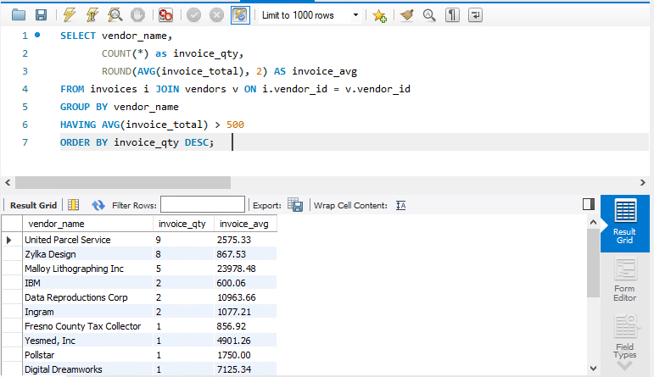
How the HAVING Clause Compares to the WHERE Clause
Processing steps in this query
The invoices in the INVOICES table are grouped by VENDOR_NAME
Calculates a count and an average for each group
The HAVING clause limits the groups in the result to an AVG(invoice_total) greater than 500
No WHERE clause was used in this example, so it includes all the records in the table
Notice the invoice_qty for Zykla Design, it is 8

Slide 28
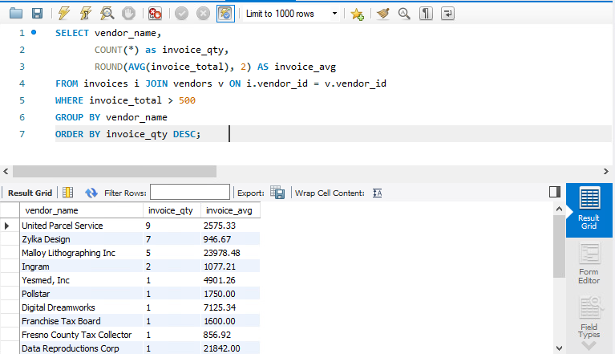
How the HAVING Clause Compares to the WHERE Clause
In this example a WHERE clause is included that limits the invoices included in the groups to an invoice total greater than 500
In other words the search condition is applied to each row
In the previous example it was applied to each group of rows
There were 8 rows for Zykla Design previously but only 7 of the invoices are over 500

Slide 29
How the HAVING Clause Compares to the WHERE Clause
When a WHERE clause is included in a SELECT statement that uses grouping and aggregates, MySQL applies the search condition before it groups the rows and calculates aggregates
When a HAVING clause is included in a SELECT statement that uses grouping and aggregates MySQL applies the search condition after it groups the rows and calculates the aggregates
A WHERE clause can refer to any column in the base tables
A HAVING clause can only refer to a column included in the SELECT clause
A WHERE clause cannot contain aggregate functions
A HAVING clause can contain aggregate function

Slide 30
Coding Compound Search Conditions
You can code compound search conditions in the HAVING clause just as you can in the WHERE clause
You can use the AND and OR operators to code compound search conditions in a HAVING clause
If a search condition includes an aggregate function it must be coded in the HAVING clause

Slide 31
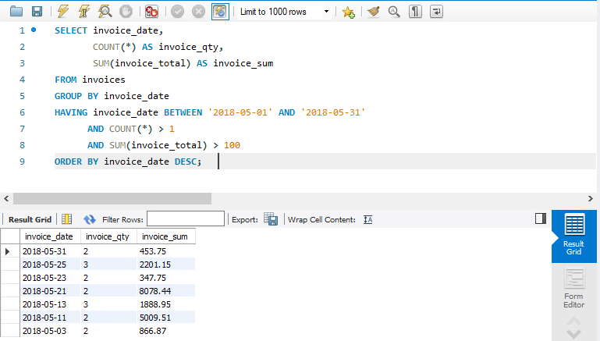
Coding Compound Search Conditions
You can use the first condition of the HAVING clause in either the HAVING or the WHERE clause
The second and third conditions of the HAVING clause must be coded in the HAVING clause since they contain aggregate functions

Slide 32
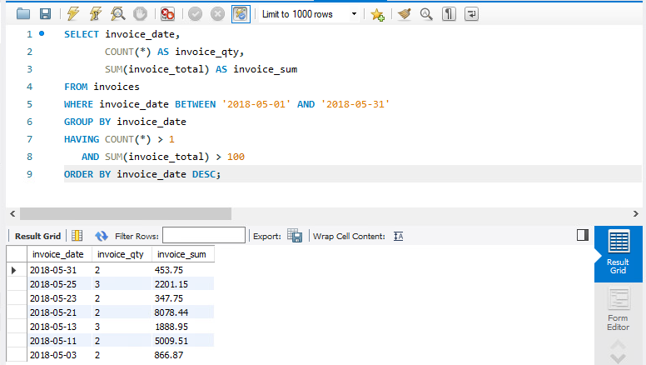
Coding Compound Search Conditions
At first glance the query on Slide 31 and this slide produce the same result
The difference between the two is that first condition was listed in the HAVING clause on slide 31
On this slide the fist condition is coded in the WHERE clause
The textbook is correct it could be coded in either the WHERE or HAVING clause, since both return the same result

Slide 33
WHERE Clause or HAVING Clause
I have a different thought about where to code the BETWEEN … AND clause of the query
If you code it in the HAVING clause it means the database had to GROUP all the data including the dates specified in the BETWEEN … AND condition, then exclude them in the HAVING clause
In the second query the WHERE clause filtered the dates specified in the BETWEEN … AND clause out before they were grouped
It would be more efficient to filter those rows with the WHERE clause before they are grouped and filtered in the HAVING clause since you do not want them included
Why use the processing time to process data you do not want to include in the result
So as far as the text says it does not matter, I take exception to that to reduce processing time

Slide 34
How to Use the WITH ROLLUP Operator
So far we have discussed standard SQL keywords and functions
MySQL provides an extension to the standard SQL that is useful for summarizing data
That is the WITH ROLLUP operator
You can use the WITH ROLLUP operator to add one or more summary rows to the result set that uses grouping and aggregates

Slide 35
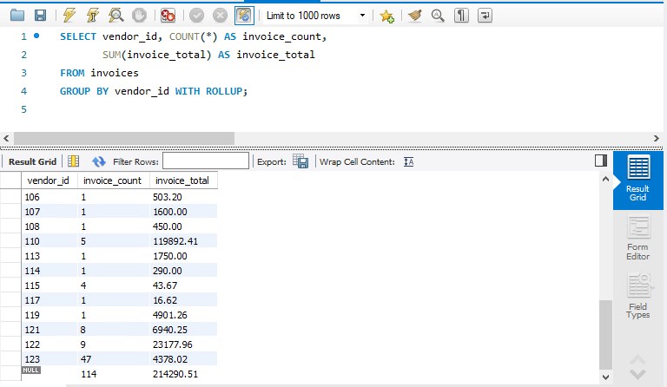
How to Use the WITH ROLLUP Operator
In this example the WITH ROLLUP operator works when you have a single column
The statement groups the invoices by the vendor_id and calculates an invoice count and invoice total for each group
In addition since the GROUP BY clause includes the WITH ROLLUP operator, this query adds a summary row to the end of the result set
This row summarizes all of the aggregate columns in the result set
It summarizes the invoice_count and the invoice_total columns
Since the vendor_id cannot be summarized it is assigned a NULL value

Slide 36
How to Use the WITH ROLLUP Operator
You can use the WITH ROLLUP operator in the GROUP BY clause to add summary rows to the final result set
The WITH ROLLUP operator adds a summary row for each group specified in the GROUP BY clause
It also adds a summary row to the end of the result set that summarizes the entire result set
If the GROUP BY clause specifies a single group, the WITH ROLLUP operator only adds the final summary row
With MySQL 8.0.13 and later you can add an ORDER BY clause to sort the result set when the GROUP BY contains a WITH ROLLUP
With MySQL 8.0.13 also allows the use of the DISTINCT keyword, prior versions it was not allowed

Slide 37
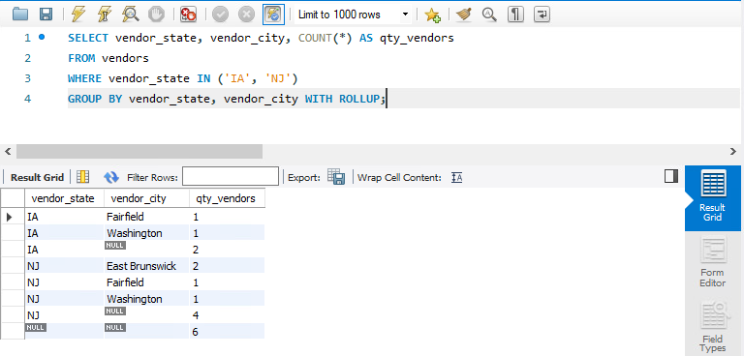
How to Use the WITH ROLLUP Operator
This query shows how the WITH ROLLUP operator works when you group by two columns
The query groups vendors by state and city and counts the number of vendors in each group
The query adds summary rows for each state, and it adds a final summary row at the end of the result set

Slide 38
How to Use the GROUPING Function
When you group by a column that contains null values, the result of the grouping can be a null value
In addition the when you use the WITH ROLLUP operator to summarize a column that contains null values, the summary row will contain a null value in that column
Because of that it can be difficult to distinguish between the null value due to grouping and the null value due to summarizing

Slide 39
How to Use the GROUPING Function
Syntax:
GROUPING(expression)

Slide 40
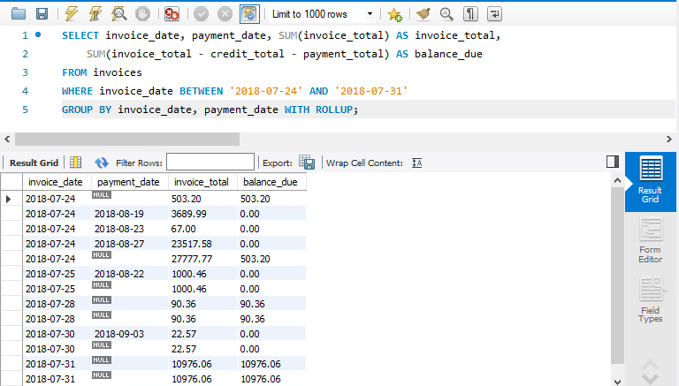
How to Use the GROUPING Function
In this example the query includes the invoice date and the payment date from the invoices table
In addition it includes the sum of the invoice totals and the sum of the invoices balances
The first five rows of the result set are for the same invoice date
The first and last row of the five rows contains a null value in the Payment Date column
The first row contains a null value because one or more of the invoices for that date contains a null value
The last row contains a null value because it is the summary row for all the invoices for that invoice date

Slide 41
How to Use the GROUPING Function
To help distinguish between these null values, you can use the GROUPING function
Introduced in MySQL 8.0
This function evaluates the expression you specify to determine of the results in a null value because it is in a summary row
If it is in a summary row the GROUPING function returns a value of 1
If it is not the GROUPING function returns a value of 0

Slide 42
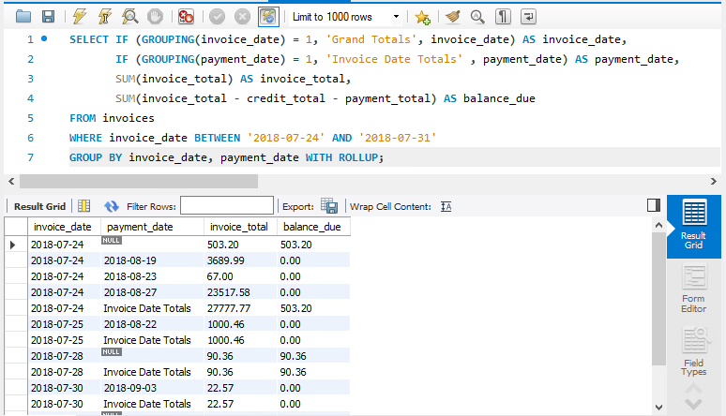
How to Use the GROUPING Function
This query is a modification of the previous query
The IF and GROUPING functions have been added for the invoice_date and payment_date columns
The IF function evaluates the first argument, it returns the value of the second argument if it is a 1 and the value of the third argument if it is a 0
Makes the summary rows more visible because they now contain literal values and not the word NULL
This is the common use for the GROUPING function
Query shows the top of the result set in addition to the end of the result set
Evaluates invoice_date
If it is a 1 output Grand Totals
If it is a 0 output the invoice_date
Last 3 rows are added

Slide 43
How to Use the GROUPING Function
If you wish to display only the summary rows that are produced by the WITH ROLLUP operator, you can include one or more GROUPIING functions in the HAVING clause

Slide 44
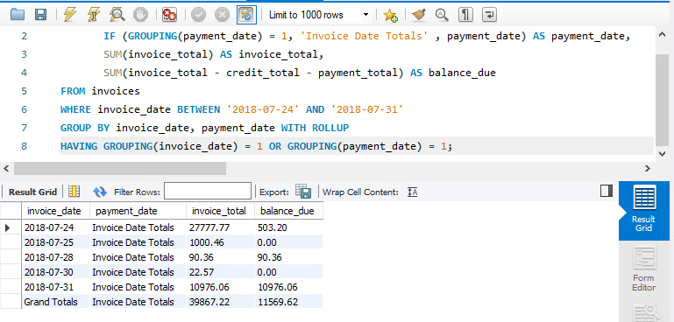
How to Use the GROUPING Function
Only summary rows are produced by the WITH ROLLUP operator
The HAVING only permits the summary rows to display
The other rows are not displayed because of the HAVING clause filtering them out

